Slide 1
Agenda
Introductions
Hello Spring Security (Java Config)
Custom Authentication
Spring Data Integration
Testing Support
WebSocket Support
White Hat Hacker

Slide 2
Topics
Change login URL
Spring Security & Spring Project Lead
Committer on Spring Framework
Co-author of Spring Security 3.1 book
Twitter @rob_winch

Slide 3
What is Spring Security?
Comprehensive support for Authentication And Authorization
Protection against common attacks
Servlet API Integration
Optional integration with Spring MVC
Optional Spring Data Integration
WebSocket Support

Slide 4

Message Application
SPRING SECURITY
Notes:
7 minutes

Slide 5

Spring Security

Slide 6
web.xml
<filter>
<filter-name>springSecurityFilterChain</filter-name>
<filter-class>
org.springframework.web.filter.DelegatingFilterProxy
</filter-class>
</filter>
<filter-mapping>
<filter-name>springSecurityFilterChain</filter-name>
<url-pattern>/*</url-pattern>
</filter-mapping>

Slide 7
Hello Java Configuration – Replaces web.xml
public class SecurityWebInitializer
extends AbstractSecurityWebApplicationInitializer {
// optionally override methods
}

Slide 8
Hello Java Configuration – WebSecurityConfig
@Configuration
@EnableWebMvcSecurity
public class WebSecurityConfig
extends WebSecurityConfigurerAdapter {
...
}

Slide 9
Hello Java Configuration – WebSecurityConfig
@Autowired
public void configureGlobal(
AuthenticationManagerBuilder auth) throws Exception {
auth
.inMemoryAuthentication()
.withUser("admin”)
.password("password”)
.roles("ADMIN","USER")
.and()
.withUser("user")
.password("password")
.roles("USER");
}

Slide 10
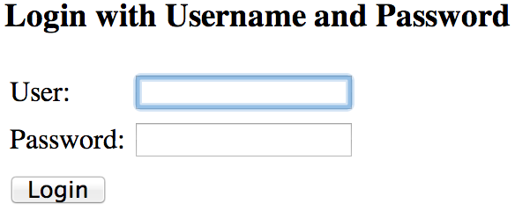
Hello Java Configuration

Slide 11


Hello Java Configuration

Slide 12
Hello Java Configuration
<div th:with="currentUser=${#httpServletRequest.userPrincipal?.name}">
<div th:if="${currentUser != null}">
<form th:action="@{/logout}" method="post”>
<input type="submit" value="Log out" />
</form>
<p th:text="${currentUser}”>
sample_user
</p>
</div>

Slide 13
Hello Java Configuration
<div th:with="currentUser=${#httpServletRequest.userPrincipal?.name}">
<div th:if="${currentUser != null}">
<form th:action="@{/logout}" method="post”>
<input type="submit" value="Log out" />
</form>
<p th:text="${currentUser}”>
sample_user
</p>
</div>
public interface HttpServletRequest … {
Principal getUserPrincipal();
...
}

Slide 14
Hello Java Configuration
<div th:with="currentUser=${#httpServletRequest.userPrincipal?.name}">
<div th:if="${currentUser != null}">
<form th:action="@{/logout}" method="post”>
<input type="submit" value="Log out" />
</form>
<p th:text="${currentUser}”>
sample_user
</p>
</div>
public interface Principal … {
String getName();
...
}

Slide 15
Hello Java Configuration
<div th:with="currentUser=${#httpServletRequest.userPrincipal?.name}">
<div th:if="${currentUser != null}">
<form th:action="@{/logout}" method="post”>
<input type="submit" value="Log out" />
</form>
<p th:text="${currentUser}”>
sample_user
</p>
</div>
</div>

Slide 16
Custom Log in Form
Notes:
13 min

Slide 17
Java Configuration
@Override
protected void configure(HttpSecurity http)
throws Exception {
http
.authorizeRequests()
.anyRequest().authenticated()
.and()
.formLogin().and()
.httpBasic();
}

Slide 18
Java Configuration
http
.authorizeRequests()
.anyRequest().authenticated()
.and()
.formLogin().and()
.httpBasic();
<http use-expressions="true">
<intercept-url pattern="/**" access="authenticated"/>
<form-login />
<http-basic />
</http>

Slide 19
Java Configuration
http
.authorizeRequests()
.anyRequest().authenticated()
.and()
.formLogin()
.loginPage("/login”)
.permitAll()
.and()
.logout()
.permitAll();

Slide 20
Java Configuration
http
.authorizeRequests()
.antMatchers("/resources/**”).permitAll()
.anyRequest().authenticated()
.and()
.formLogin()
.loginPage("/login”)
.permitAll()
.and()
.logout()
.permitAll();

Slide 21
Java Configuration
<form th:action="@{/login}" method="post">
<label for="username">Username</label>
<input type="text" id="username" name="username"/>
<label for="password">Password</label>
<input type="password" id="password" name="password"/>
<button type="submit">Log in</button>
</form>

Slide 22
Java Configuration
<form th:action="@{/login}" method="post">
<label for="username">Username</label>
<input type="text" id="username" name="username"/>
<label for="password">Password</label>
<input type="password" id="password" name="password"/>
<button type="submit">Log in</button>
</form>

Slide 23
Java Configuration
<form th:action="@{/login}" method="post">
<label for="username">Username</label>
<input type="text" id="username" name="username"/>
<label for="password">Password</label>
<input type="password" id="password" name="password"/>
<button type="submit">Log in</button>
</form>
http
….
.formLogin()
.loginPage("/login”)

Slide 24
Custom Authentication
Notes:
20 min / 25 min

Slide 25
Java Configuration – Custom Authentication
public interface UserDetailsService {
UserDetails loadUserByUsername(String username)
throws UsernameNotFoundException;
}

Slide 26
Java Configuration – Custom Authentication
public interface UserDetails extends Serializable {
Collection<? extends GrantedAuthority> getAuthorities();
String getPassword();
String getUsername();
boolean isAccountNonExpired();
boolean isAccountNonLocked();
boolean isCredentialsNonExpired();
boolean isEnabled();
}

Slide 27
Java Configuration – Custom Authentication
@Entity
public class User implements Serializable {
@Id
@GeneratedValue(strategy = GenerationType.AUTO)
private Long id;
private String firstName;
private String lastName;
private String email;
private String password;
...
}

Slide 28
Java Configuration – Custom Authentication
pubic class CustomUserDetails extends User
implements UserDetails {
public CustomUserDetails(User u) {
super(user);
}
public Collection getAuthorities() {
return AuthorityUtils.createAuthorityList("ROLE_USER");
}
public String getUsername() {
return getEmail();
}
public boolean isEnabled() { return true; }
...

Slide 29
Java Configuration – Custom Authentication
public UserDetails loadUserByUsername(String username)
throws UsernameNotFoundException {
User user = userRepository.findByEmail(username);
if(user == null) {
throw new UsernameNotFoundException(…);
}
return new CustomUserDetails(user);
}

Slide 30
Java Configuration – Custom Authentication
@Autowired
public void configureGlobal(
AuthenticationManagerBuilder auth,
UserDetailsService userDetailsService)
throws Exception {
auth
.userDetailsService(userDetailsService);
}

Slide 31
Java Configuration – Custom Authentication
<div th:with="currentUser=${#httpServletRequest.userPrincipal?.name}">
<div th:if="${currentUser != null}">
<form th:action="@{/logout}" method="post”>
<input type="submit" value="Log out" />
</form>
<p th:text="${currentUser}”>
sample_user
</p>
</div>

Slide 32
Java Configuration – Custom Authentication
<div th:with="currentUser=${#httpServletRequest.userPrincipal?.name}">
<div th:if="${currentUser != null}">
<form th:action="@{/logout}" method="post”>
<input type="submit" value="Log out" />
</form>
<p th:text="${currentUser}”>
sample_user
</p>
</div>
public interface HttpServletRequest … {
Principal getUserPrincipal();
...
}

Slide 33
Java Configuration – Custom Authentication
<div th:with="currentUser=${#httpServletRequest.userPrincipal?.name}">
<div th:if="${currentUser != null}">
<form th:action="@{/logout}" method="post”>
<input type="submit" value="Log out" />
</form>
<p th:text="${currentUser}”>
sample_user
</p>
</div>
public interface HttpServletRequest … {
(Authentication) Principal getUserPrincipal();
...
}

Slide 34
Java Configuration – Custom Authentication
<div th:with="currentUser=${#httpServletRequest.userPrincipal?.principal}">
<div th:if="${currentUser != null}">
<form th:action="@{/logout}" method="post”>
<input type="submit" value="Log out" />
</form>
<p th:text="${currentUser}”>
sample_user
</p>
</div>
public interface Authentication … {
Object getPrincipal();
...
}

Slide 35
Java Configuration – Custom Authentication
<div th:with="currentUser=${#httpServletRequest.userPrincipal?.principal}">
<div th:if="${currentUser != null}">
<form th:action="@{/logout}" method="post”>
<input type="submit" value="Log out" />
</form>
<p th:text="${currentUser}”>
sample_user
</p>
</div>
public interface Authentication … {
(UserDetails) Object getPrincipal();
...
}

Slide 36
Java Configuration – Custom Authentication
<div th:with="currentUser=${#httpServletRequest.userPrincipal?.principal}">
<div th:if="${currentUser != null}">
<form th:action="@{/logout}" method="post”>
<input type="submit" value="Log out" />
</form>
<p th:text="${currentUser}”>
sample_user
</p>
</div>
public interface Authentication … {
(CustomUserDetails) Object getPrincipal();
...
}

Slide 37
Java Configuration – Custom Authentication
public class CustomUserDetails … {
String getFirstName();
...
}
<div th:with="currentUser=${#httpServletRequest.userPrincipal?.principal}">
<div th:if="${currentUser != null}">
<form th:action="@{/logout}" method="post”>
<input type="submit" value="Log out" />
</form>
<p th:text="${currentUser.firstName}”>
sample_user
</p>
</div>

Slide 38
Java Configuration – Custom Authentication
@RequestMapping(method=RequestMethod.GET)
public ModelAndView list() {
SecurityContext ctx =
SecurityContextHolder.getContext();
Authentication authentication = ctx.getAuthentication();
User custom = authentication == null ?
null : (User) authentication.getPrincipal();
...
}

Slide 39
Java Configuration – Custom Authentication
@RequestMapping(method=RequestMethod.GET)
public ModelAndView list(Authentication authentication) {
User custom = authentication == null ?
null : (User) authentication.getPrincipal();
...
}

Slide 40
Java Configuration – Custom Authentication
@RequestMapping(method=RequestMethod.GET)
public ModelAndView list(
@AuthenticationPrincipal User currentUser) {
...
}

Slide 41
Java Configuration – Custom Authentication
@Target(ElementType.PARAMETER)
@Retention(RetentionPolicy.RUNTIME)
@Documented
@AuthenticationPrincipal
public @interface CurrentUser { }

Slide 42
Java Configuration – Custom Authentication
@RequestMapping(method=RequestMethod.GET)
public ModelAndView list(
@CurrentUser User currentUser) {
Iterable<Message> messages =
messageRepository.findByToId(currentUser.getId());
...
}

Slide 43
Spring Security / Spring Data
SpEL Support
Notes:
33 min / 38 min

Slide 44
Spring Security / Spring Data
@Bean
public SecurityEvaluationContextExtension
securityEvaluationContextExtension() {
return new SecurityEvaluationContextExtension();
}

Slide 45
Spring Security / Spring Data
public interface MessageRepository
extends CrudRepository<Message, Long> {
@Query("select m from Message m where m.to.id = " +
"?#{principal.id}”)
Iterable<Message> findAllToCurrentUser();
}

Slide 46
Spring Security / Spring Data
public interface MessageRepository
extends CrudRepository<Message, Long> {
@Query("select m from Message m where m.to.id = " +
"?#{hasRole('ROLE_ADMIN') ? '%' : principal.id}”)
Iterable<Message> findAll();
}

Slide 47

Spring Security / Spring Data

Slide 48
In the year 2000….
@EnableAclSecurity
public interface SecuredMessageRepository
extends MessageRepository {}

Slide 49
Password Storage
Notes:
53

Slide 50
Password Storage
auth
.userDetailsService(userDetailsService)
.passwordEncoder(new BCryptPasswordEncoder());

Slide 51
CSRF Protection
Notes:
39 min

Slide 52
CSRF Protection
SPRING SECURITY

Slide 53
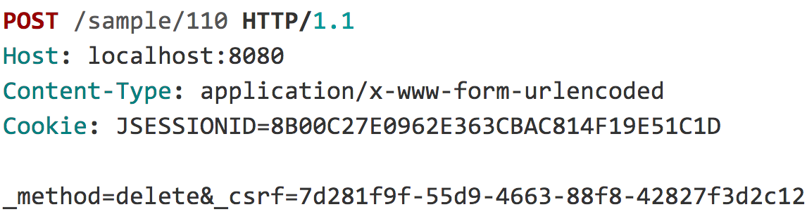
CSRF Protection

Slide 54
CSRF Protection

Slide 55
CSRF Protection
“
When do I use CSRF protection?
Notes:
When the application is intended to be ran in a browser

Slide 56
CSRF Protection
“
... but my application uses JSON

Slide 57
CSRF Protection
<form ... method="post" enctype="text/plain">
<input type='hidden'
name=’{"summary":"Hi", … "ignore_me":"' value='test"}'
/>
</form>

Slide 58
CSRF Protection
{
"summary": "Hi",
"message": "New Message",
"to": "luke@example.com",
"ignore_me": "=test"
}

Slide 59
CSRF Protection
“
… but my application is stateless

Slide 60
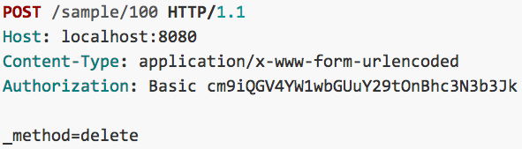
CSRF Protection

Slide 61
CSRF Protection
“
…and I use a custom header for authentication and ignore cookies

Slide 62
CSRF Protection
Use proper HTTP Verbs
Configure CSRF Protection
Include the CSRF Token

Slide 63
CSRF Protection – Providing the Token
<form ... method="post">
...
<input type="hidden"
name="${_csrf.parameterName}"
value="${_csrf.token}"/>
</form>

Slide 64
CSRF Protection – Providing the Token
<form ... method="post">
...
<sec:csrfInput />
</form>

Slide 65
CSRF Protection – Providing the Token
<form:form … method="post”>
...
</form:form>

Slide 66
CSRF Protection – Providing the Token
<form ... method="post">
...
<input type="hidden" name="_csrf" value="f81d4fae-…"/>
</form>

Slide 67
Security HTTP Response Headers
Notes:
52 min

Slide 68
Click Jacking
SPRING SECURITY

Slide 69
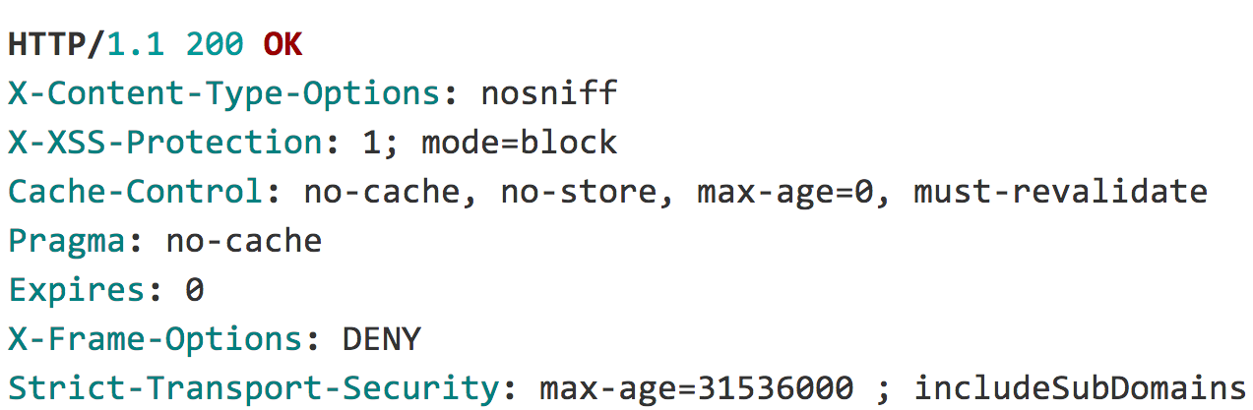
Security HTTP Response Headers
Notes:
112 min

Slide 70
Security HTTP Response Headers

Slide 71
Test Support
Notes:
101 min

Slide 72
Testing Support
@Before
public void setup() {
Authentication auth =
new TestingAuthenticationToken("user",”pass","ROLE_USER");
SecurityContext ctx =
SecurityContextHolder.getContext();
ctx.setAuthentication(auth);
SecurityContextHolder.setContext(ctx);
}
@After
public void cleanup() {
SecurityContextHolder.clearContext();
}

Slide 73
Testing Support
UserDetails user = ...
List<GrantedAuthority> roles =
AuthorityUtils.createAuthorityList("ROLE_USER");
Authentication auth =
new UsernamePasswordAuthenticationToken(user,”pass", roles);
SecurityContext ctx =
SecurityContextHolder.getContext();
ctx.setAuthentication(auth);

Slide 74
Testing Support
User user = ...
List<GrantedAuthority> roles =
AuthorityUtils.createAuthorityList("ROLE_USER");
Authentication auth =
new UsernamePasswordAuthenticationToken(user,”pass", roles);
SecurityContext ctx =
SecurityContextHolder.getContext();
ctx.setAuthentication(auth);

Slide 75
Testing Support
...
@WithMockUser
public class SecurityMethodTests {
...
}

Slide 76
Testing Support
...
public class SecurityMethodTests {
@Test
@WithMockUser
public void findAllMessages() {
...
}
}

Slide 77
Testing Support
...
public class SecurityMethodTests {
@Test
@WithMockUser(username="admin",roles="ADMIN”)
public void findAllMessages() {
repository.findAll();
}
}

Slide 78
Testing Support
...
public class SecurityMethodTests {
@Test
@WithUserDetails(”rob@example.com")
public void findAllMessages() {
repository.findAll();
}
}

Slide 79
Testing Support
@Target({ ElementType.METHOD, ElementType.TYPE })
@Retention(RetentionPolicy.RUNTIME)
@Inherited
@Documented
@WithSecurityContext(factory = WithCustomUserSecurityContextFactory.class)
public @interface WithCustomUser {
String email() default "rob@example.com";
String firstName() default "Rob";
String lastName() default "Winch";
long id() default 0L;
}

Slide 80
Testing Support
public class WithCustomUserSecurityContextFactory
implements WithSecurityContextFactory<WithCustomUser> {
public SecurityContext
createSecurityContext(WithCustomUser customUser) {
User principal = new User();
principal.setEmail(customUser.email());
...
return ctx;
}
}

Slide 81
Testing Support
...
public class SecurityMethodTests {
@Test
@WithCustomUser
public void findAllMessages() {
repository.findAll();
}
}

Slide 82
Testing Support
...
public class SecurityMethodTests {
@Test
@WithCustomUser(id=1,email=”luke@example.com")
public void findAllMessages() {
repository.findAll();
}
}

Slide 83
Testing Support
“
…what about Spring Test MVC?

Slide 84
Testing Support
...
public class SecurityMockMvcTests {
@Before
public void setup() {
mvc = MockMvcBuilders
.webAppContextSetup(context)
.apply(springSecurity())
.build();
}

Slide 85
Testing Support
@Test
@WithCustomUser
public void inboxShowsOnlyTo() throws Exception {
...
}

Slide 86
Testing Support
@Test
@WithCustomUser(id=1,email=”luke@example.com")
public void inboxShowsOnlyTo() throws Exception {
...
}

Slide 87
Testing Support
@Test
@WithCustomUser
public void compose() throws Exception {
MockHttpServletRequestBuilder compose = post("/”)
.param("summary", "Hello Luke”)
.param("message", "This is my message”)
.with(csrf());
mvc
.perform(compose)
.andExpect(status().is2xxSuccessful());
}

Slide 88
WebSocket Security
Notes:
108 min
Already have authentication, how it works, need authorization

Slide 89
Web Socket
Authorization
SPRING SECURITY

Slide 90
WebSocket Authorization
Browser
/app/im
@MessageMapping("/im")
/queue/messages-user<id>
Client (Web Browser)

Slide 91
WebSocket Authorization
@Configuration
public class WebSocketSecurityConfig extends
AbstractSecurityWebSocketMessageBrokerConfigurer {

Slide 92
WebSocket Authorization
protected void configure(
MessageSecurityMetadataSourceRegistry messages) {
messages
.matchers(message("/topic/**","/queue/**")).denyAll()
.anyMessage().hasRole("USER");
}

Slide 93
WebSocket Authorization
// avoid processing outbound channel
public void configureClientOutboundChannel(
ChannelRegistration registration) {}

Slide 94
WebSocket Security
Spring Session
Notes:
Keep Alive, Clustering, determine session id in header, allow users to invalidate suspicious sessions, sessions on other systems (i.e. Messaging)

Slide 95

Learn More. Stay Connected.
Source http://github.com/rwinch/spring-security-0-to-4.0
http://spring.io/spring-security
Twitter: @rob_winch
Security for Microservices with Spring & OAuth2 – 4:30 Today
Notes:
132 min

